Slide 1

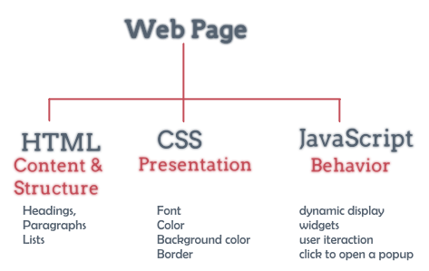
INTRODUCTION
Graphic Design and Web Business Development

Slide 2
Course Objectives
Provide students the knowledge of web graphic design principles: web layouts, color schemes, visual principles; knowledge of designing and building web applications in both front-end and back-end components.
Equipping students with basic to advanced knowledge of web programming, subject content includes:
HTML - CSS - JavaScript
XML, HTML DOM
AJAX
JSON, AngularJS
Typescript
Nodejs
MongoDB

Slide 3
Assessments
Final Term: 50% (Project)
Mid-Term: 20% (Practice Exam)
On-Goding: 30%
Presentation (subject project, maximum 5 students in each group)
Group discussion in class (subject knowledge, advanced knowledge, maximum 5 students in each group)
Class exercises (some exercises are submitted directly in the practical class)
Homework (Some exercises require any homework)
Bonus points: Add to the process score, depending on the content of the lesson that the Student can solve

Slide 4
Assessments
Assignments, discussions, projects, exams… all must be submitted on https://lms.uel.edu.vn/
Absence from school for more than 3 sessions: Forbidden Exam
Do not submit required assignments on Elearning more than 3 times: Banned
Study the lecture before going to class

Slide 5
Tools for Development
Programming tools:
Visual Studio (2012, 2013, 2015, 2017, 2022...)
Visual Code
Notepad++
Eclipse
Web Server
IIS Web Server
Apache
Web Browser:
Chrome
Firefox
IE

Slide 6
Documents
Main document:
[1]Responsive Web Design with HTML5 and CSS: Build future-proof responsive websites using the latest HTML5 and CSS techniques, 2022 (Ben Frain; publisher Packt Publishing; ISBN: 978-1803242712)
Reference documents
[2] Programming in HTML5 with JavaScript and CSS3, 2013 (Glenn Johnson; publisher Microsoft Press; ISBN: 978-0-7356-7438-7)
[3] Head First JavaScript Programming: A Brain-Friendly Guide, 2014 (Eric Freeman, Elisabeth Robson; publisher O'Reilly Media; ISBN: 978-1449340131)
[4] Head First jQuery: A Brain-Friendly Guide, 2011 (Ryan Benedetti, Ronan Cranley; publisher O'Reilly Media; ISBN: 978-1449393212)
[5] Professional AngularJS, 2015 (Valeri Karpov, Diego Netto; publisher Wrox; ISBN: 978-1118832073)
Website for learning:
https://www.google.com
https://www.w3schools.com , https://www.tutorialspoint.com
https://stackoverflow.com , https://www.codeproject.com

Slide 7
Lecturer information
Full name: Tran Duy Thanh
Email: thanhtd@uel.edu.vn
Phone: 0987773061
Blog : https://tranduythanh.com
Note: All emails about learning issues will be answered at the latest after 24 hours, if you do not see a reply, please call to remind because the email may be in Spam.

Slide 8


Hey! Coding is easy!
END

